Slide 1
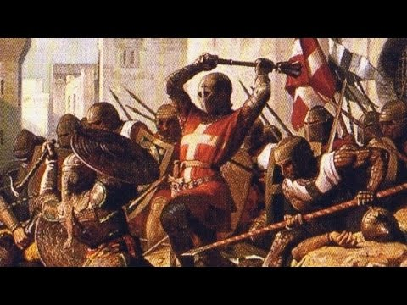
CRUSADERS

Slide 2
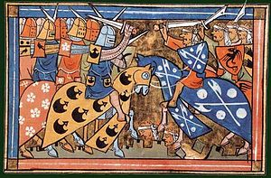
CRUSADERS
THE CRUSADERS WERE SERIES OF RELIGIOUS WAR FOUGHT BETWEEN 1096-1291.

Slide 3
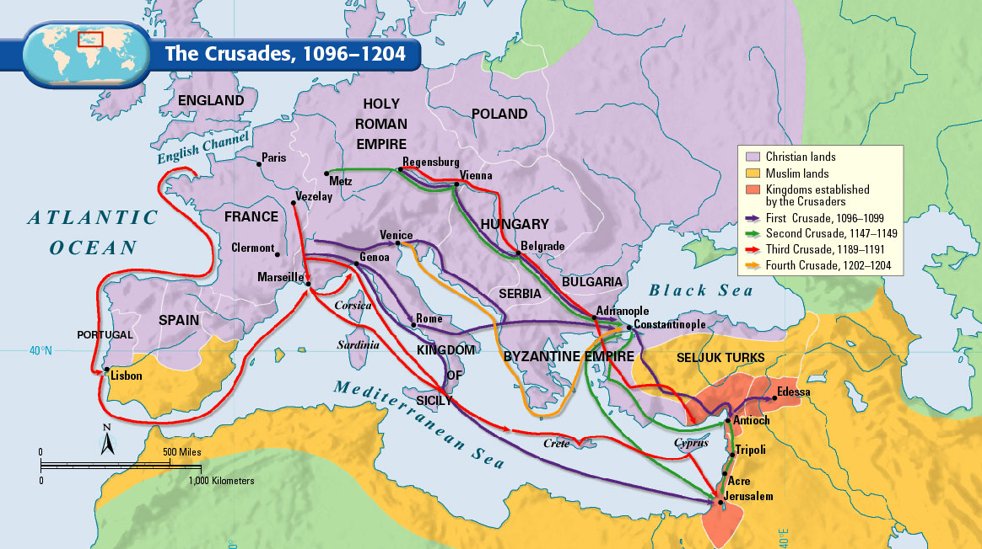
SPEARD OF CURSADES

Slide 4
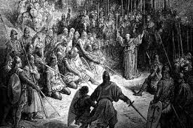
POSITVE IMPACTS ON CHRISANITY
MONARCHS BECAME MORE POWERFUL.
NEW FOOD PORDUCTS.
NEW CLOTHING.

Slide 5
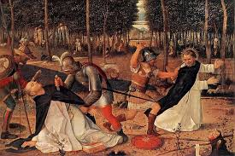
NEGATIVE IMPACT ON CHRISTANITY
DISTRUST OF CHRISTIAN
UNDERMINING CHRUCH MORAL AUTHORITY
OPENED WAY FOR FUTURE MUSLIMS

Slide 6
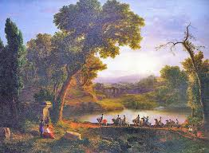
POSTIVE IMPACT ON ISALM
NEW MILITARY TECHNIQUES
MERCHANTS EARNED MONEY
NEW MOSQUES BUILD.

Slide 7
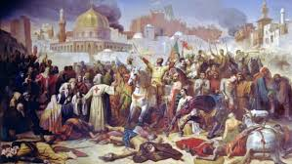
NEGATIVE IMPACT ON ISLAM
MANY DIED IN BATTLES.
MANY DIED IN MASSACERS
CURSADERS DESTORYED THEIR PROPERTY

Slide 8
IMPACT ON CITIZENS ON EUROPE AND MIDDLE EAST
EUROPE-
DEVELOPMENT OF MILITARY POWER
INCREASE IN POWER ON ROYAL HOUSES OF THE EUROPE
STRONGER COLLECTIVE CULTURAL IDENTITY IN EUROPE
MIDDLE EAST-
POWER OF MILITARY GETTING MORE STRONGER HENCE NEW PEOPLE GETTING RECURITED
THE ISLAM CAPTURED MORE TERRITORIES
NEW WORLD ADDED IN THEIR LIFE WHICH IS HOLY WAR

Slide 9
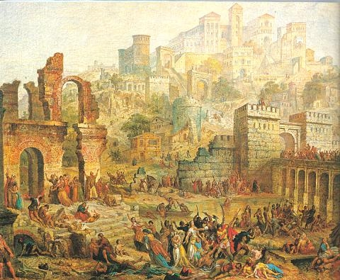

Slide 10
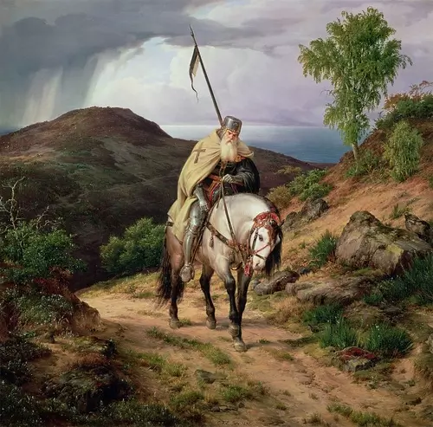
CONCLUSION

Slide 11


